Slide 1

College of Science & Engineering Technology
FY 2024 Planning and Budget Meeting

Slide 2
Science and Engineering Technology
School of Agricultural Sciences
Departments of
  Biological Sciences
  Chemistry
  Computer Science
  Engineering Technology
  Environmental and Geosciences
  Mathematics and Statistics
  Physics and Astronomy

Slide 3
FY 2023 Accomplishments
Priority 1: Prioritize Student Success and Student Access
  Largest increase in undergraduate enrollment university-wide in Fall 2022 (4.3%) and Spring 2023 (7.4%)
  Student success initiatives to address achievement gaps in Calculus, General Chemistry, and Weather & Climate, partnering with ASC, STEM Center, PACE, Testing Center, and SAM Center
  Pilot of a new suspension readmission process with data collection to inform interventions
  Approval of a new B.S. Data Science to launch Fall 2023, in partnership with COBA
  Approval of a 4+1 BS/MS Computing and Data Science Program, supported by a THECB grant and officially launching Fall 2023.
  Establishment of the Science Training Community for Neurodiverse Students
  Data Science Pathway on the Zeus Platform, developed and run in partnership with Texas State University and expanding to Lamar University. The first of several non-traditional paths to academic credit.
  Establishment of dual-enrollment Agriculture courses in partnership with Blinn College

Slide 4
FY 2023 Accomplishments
Priority 2: Embody a Culture of Excellence
  First in total grant proposal submissions and second in dollars awarded in FY22
  $2.8 million National Science Foundation CyberCorps Scholarship for Service grant in Interdisciplinary Cyber Security and Cyber Forensics.
  Computer Science programs recognized in U.S. News & World Report.
    No. 20 in Best Online Master's in Computer Information Technology Programs
    No. 10 in Best Online Master's in Computer Information Technology Programs for Veterans
  American Association of Geographers Distinguished Teaching Award (John Strait and Ava Fujimoto-Strait).

Slide 5
FY 2023 Accomplishments
Priority 3: Elevate the Reputation and Visibility of SHSU
  Expansion of Gibbs Ranch to provide more community events, partnerships, and outreach
  Expansion of the Dominey Observatory as a state-of-the-art ADA compliant observatory
  SkillsUSA Conference: a high-school student leadership conference for ~700 students, in partnership with CAM, CHSS, CJ, COBA, COHS, and COM

Slide 6
FY 2023 Accomplishments
Priority 4: Expand and Elevate our Service to the State and Beyond
  Partnership between Engineering Technology and Entergy to provide the community with a fast-charging EV charging station
  Girl Scout STEM Day, a STEM exploration experience for ~50 local Girl Scouts
  Geoscience and Exposure and Training in Texas (GET TX) partnership with Lone Star College, designed to broaden participation of underrepresented populations in the geosciences
  Data Science for Energy Transition summer bootcamp partnership with University of Houston, offering a path into energy transition research to students of any major
  Workforce-based Engineering Technology courses offered for Quanta Services
  Building an Engaging Placed-Based Geography Learning Community in Metro Houston project funded by National Geographic Society, bridges secondary and post-secondary geography curricula by equipping high school teachers to offer place-based learning AN ENGAGING PLACE - BASED GEOGRAPHY LEARNING COMMUNITY IN METRO HOUSTON

Slide 7
Budget Request
#1 Budget Priority | Mathematics Student Success Initiative: Faculty Stabilization
Aligned with Strategic Priority Goal | Strategic Priority 1 Goal 1: Recruit, retain, graduate, and empower students to drive sustainable growth.
Amount Requested | $343,094
Frequency of Need | Recurring
Opportunity Statement | This funding converts 10 pool faculty FTE to 10 visiting assistant professor lines. Adjunct and lecturer faculty positions are difficult to fill, but new PhDs are often looking for teaching/research experience for 1 – 3 years before beginning tenure-track positions. These VAPs can provide quality classroom instruction and research collaborations for current faculty. If the Department can redirect energy normally spent on hiring and onboarding adjunct faculty, then it can focus on students and student success efforts. If the SAM Center can reliably count on availability of course sections, then it can focus its attention on other student support needs.
Risk Statement | The immediate risk is that COSET will be unable to offer up to 80 sections of required mathematics courses per year. With an average of 30 students per section, this impacts approximately 2400 students per year.

Slide 8
Supportive Data

Slide 9
Budget Request
#3 Budget Priority
What is the request?
#2 Budget Priority | Agricultural Sciences Lecturer for SHSU/Blinn Partnership
Aligned with Strategic Priority Goal | Strategic Priority 1 Goal 1: Recruit, retain, graduate, and empower students to drive sustainable growth.
Amount Requested | $93,945
Frequency of Need | Recurring
Opportunity Statement | This initiative would fund a lecturer to teach (PLSC 2399 and ANSC 2360) for the SHSU/Blinn dual enrollment partnership. This person will also advise Blinn students wishing to pursue a degree at SHSU. The funds support a salary, benefits, course supplies, and the cost to travel to Blinn campuses. This would benefit students wishing to transfer from Blinn to SHSU and develop an SHSU presence at both Blinn campuses to create recruiting pipeline not only for Agricultural Sciences but also for associated STEM programs.
Risk Statement | SHSU could not offer Plant Science and Animal Science courses on Blinn College campuses. This would jeopardize the partnership recently established.

Slide 10
Budget Request
#2 Budget Priority
What is the request?
#3 Budget Priority | Assistant Professor of Data Science
Aligned with Strategic Priority Goal | Strategic Priority 1 Goal 1: Recruit, retain, graduate, and empower students to drive sustainable growth.
Amount Requested | $121,800
Frequency of Need | Recurring
Opportunity Statement | THECB just approved the B.S. in Data Science to begin Fall 2023. Few universities in Texas offer this degree but the job market is growing rapidly (projected to grow at least 36% by 2031). The degree is likely to attract students that would not otherwise enroll at SHSU. In addition, Congress is considering funding specifically for K – 12 and post-secondary Data Science education. The American Statistical Association has prioritized establishing pathways to 4-year Data Science degrees. This faculty member would teach courses in the new degree, support existing statistics service courses, and help seek funding.
Risk Statement | If we do not soon have at least one tenure-track faculty whose specialty is in Data Science, this will hamper and even potentially jeopardize this new major.

Slide 11
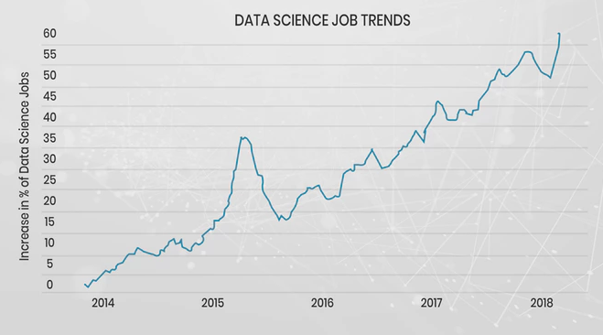
Supportive Data
Institution | 2016 | 2017 | 2018 | 2019 | 2020
Enrollment
UHD | NA | NA | 39 | 127 | 98
SFA | NA | NA | NA | 11 | 15
UTD | NA | NA | NA | 135 | 295
UTSA | 87 | 97 | 95 | 112 | 136
Enrollment Trends at Comparable Texas Institutions
Job Market

Slide 12
Budget Request
#4 Budget Priority
What is the request?
#4 Budget Priority | Assistant Professor of Cybersecurity
Aligned with Strategic Priority Goal | Strategic Priority 1 Goal 1: Recruit, retain, graduate, and empower students to drive sustainable growth.
Amount Requested | $115,200
Frequency of Need | Recurring
Opportunity Statement | The cybersecurity workforce has reached an all-time high and there's a global shortage of 3.4 million workers in this field, according to the 2022 (ISC)2 Cybersecurity Workforce Study. The BS in Cybersecurity program is tripled in size from 2020 to 2022 and is expected for further growth with the new NSF SFS program and the CAE designation. This position is needed to support high course demand, students' research and hands-on activities with the new collaborative partnerships on campus and outside of SHSU including the institutions of the CAE network and U.S. Cyber Command Academic Engagement Network.
Risk Statement | An additional faculty member is needed due to class sizes being capped at 30 students with a demand of 60 students. If this position is not permanently funded, students will have to be waitlisted resulting in possible graduation delay or seeking an alternative institution for their degree.

Slide 13
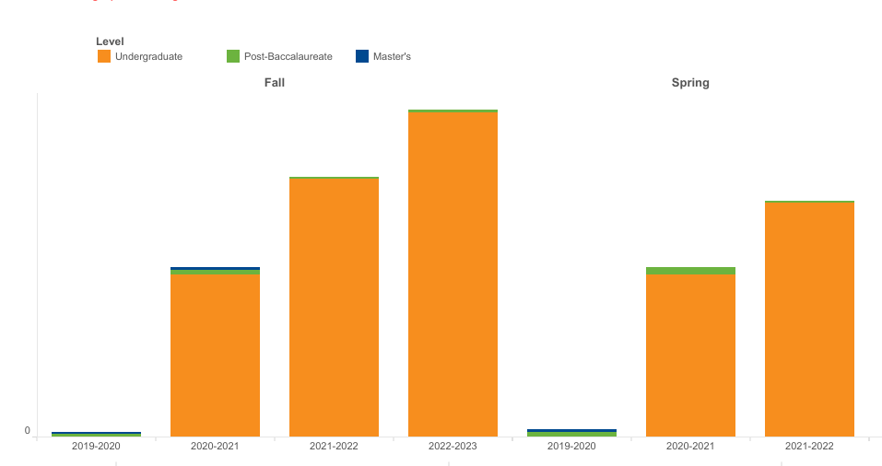
Supportive Data

Slide 14
Budget Request
#5 Budget Priority
What is the request?
#5 Budget Priority | HEF: New Faculty Start-Up Support
Aligned with Strategic Priority Goal | Strategic Priority 2 Goal 1: Academic Excellence
Amount Requested | $230,000
Frequency of Need | One-time
Opportunity Statement | These funds were negotiated as part of the start-up packages for 4 faculty hires in COSET - 1 each in Agricultural Sciences, Biological Sciences, Engineering Technology, and Environmental and Geosciences. The equipment is vital to their productivity as researchers, which impacts their students and SHSU’s research activity level.
Risk Statement | Newly hired faculty would be incapable of conducting research, obtaining external funding, or offering student research experiences. Qualified faculty and students would go elsewhere.

Slide 15
Supportive Data
Department | Discipline | Request | Comparable Awards*
Agricultural Sciences | Wildlife Management | $60,000 | No comparable data. Agricultural Education median award = $47,500
Biological Sciences | Microbiologist | $60,000 | Median award = $357,500
Engineering Technology | Mechanical Engineering | $50,000 | No comparable data Professional University Award = $119,185 Master’s Medium = $206,250
Environmental and Geosciences | Geography | $60,000 | No comparable data Master’s Smaller = $20,000 Median 2021 = $90,000**
*Data collected from the Council of Colleges of Arts & Sciences 2022 New Hire Survey
**Data collected from the Council of Colleges of Arts & Sciences 2021 New Hire Survey

Slide 16
Summary of Budget Requests
Mathematics Visiting Assistant Professors – $ 343,094
Agricultural Sciences Lecturer – $ 93,945
Assistant Professor of Data Science – $ 121,800
Assistant Professor of Cybersecurity – $ 115,200
HEF: Start-up Funds for New Faculty – $ 230,000
*Total Amount Requested – $ 904,039

Slide 17
Self-funded New Initiatives
A visiting assistant professor of Biological Sciences to support Goal 1.1: Recruit, retain, graduate, and empower students to drive sustainable growth. ($79,216 in DLF)
Supplement departmental O & M to address increases costs to support Goal 1.1: Recruit, retain, graduate, and empower students to drive sustainable growth. ($39,460 in DLF)
Gibbs Ranch classroom technology to support Goal 1.1: Recruit, retain, graduate, and empower students to drive sustainable growth. ($68,171 in DLF)

Slide 18
Prospective “Big Ideas”
Market-Driven Collaborative Programs
  Crime Analysis and Mapping Minor
  Data Science for Health Sciences Track
  M.S. in Business Security and Resilience
  Agile and OSHA Certifications
  Cybersecurity Micro-credentials
  Drone Piloting Certificates/Credentials
  CHIPS Semiconductor Training
  Engineering Technology Concrete Management
  Biomedical Engineering Technology Concentration
  Biomedical Research Training
Regional Security Operation Center (RSOC) @SHSU
Gibbs Ranch Expansion: Phase II
Dominey Observatory Expansion: Phase II

Slide 19
Questions?

